Slide 1
Introduction to MVC

Slide 2
Introduction to the MVC design pattern
Model = classes(objects)
View = web page(Razor HTML)
Controller = connects models, business logic and web pages.
The MVC design pattern helps to enforce separation of concerns to help you avoid mixing presentation logic, business logic and data access logic together.

Slide 3
Model View Controller Design Pattern
Model : manages the behavior and data
View : manages the display of data
Controller : handles page events and navigation between pages.

Slide 4
What a Website looks like Using MVC?
user
www.site.com/orders?date=today
Router
routes(name:”Orders”, url:”{Orders}”)
View
Controller
Get View(“showOrders.html”,oList)
Orders oList = Store.getOrders(today)
Database
Model
Select * from orders where Date = ‘today’

Slide 5
Explanation
A user sends a request to Router, Router will then send this information to the controller.
The controller then says to Model that he looking at the routes details containing name as Orders and it has specific URL and then it creates a list of all the orders.
So, it gets the list of orders from the store for the date=‘today’.
The SQL Query will be executed and it will be returned to the Model, then Model will pass it to the Controller.
Now Controller has list of orders data. It will then send the data off to the View.
View will then generate the list of data that will be in HTML format and then send it to the browser to render.
And so when we get back to the User, we have fully formed Web Page.
So, all of these in the background are called every time you click something on a website generating a dynamically produced web page that would show you todays orders.

Slide 6
View
View is a piece of HTML CSS code or similar.
Usually gets a list of data from the controller.
It dynamically creates the page using C# and HTML language in a template.
That language is called Razor(ASP.NET).

Slide 7
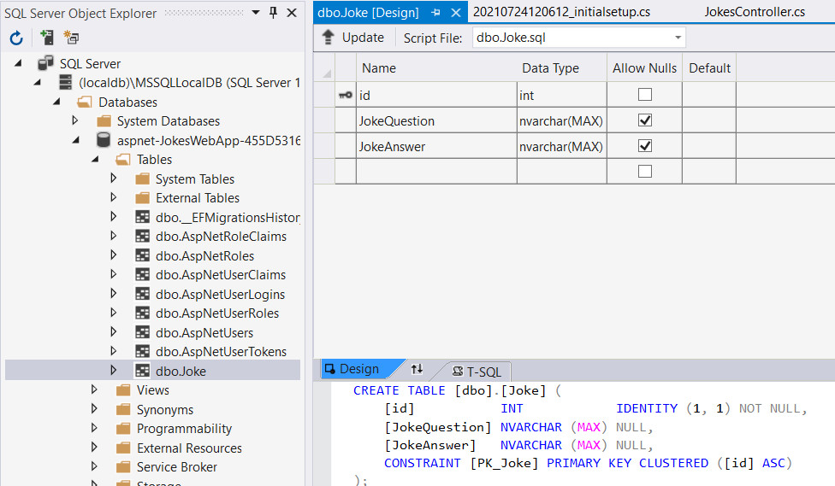
Model
Model is always Data related.
It consists of classes / objects with properties.
Uses SQL statements.
Model is usually supplied by the database , which it then supplies the controller with lists of objects, then sent to the View to render on the browser.
To create new model, right-click->Add->Class->Joke.cs
Now to create a database we need to use Database migrations.
Open Package manager Console from Tools->NuGet Package Manager->Package Manager Console, opens at the bottom window.
It is used to install new dependencies. However, we are going to use it for database management.
>add-migration “initialsetup”.
>update-database
Then check into SQL Server Object explorer on LHS.

Slide 8
Object Relation Mapper
In ORM, each table is represented as class object.
Here Mapping is between class and table.
Class Person
int ID
String Name
String Phone
int Age
ID | NAME | PHONE | AGE
101 | George | (402)-923-1146 | 29
102 | Victoria | (233)-552-0982 | 42
103 | Sherry | (917)-295-2955 | 18
ORM
There are two options for creating Database system :
Object Relational Mapper(ORM) is a popular tool but its not the only way, the other one is DAO.
Data Access Object(DAO), which is a traditional way.
DAO, manually create tables and is a Traditional method of database access.
Write your own SQL statements.
Most people that manage databases like DBA’s(database Managers), Company usually prefer old fashioned method i.e. DAO, because it provides more visibility on finding problems and its not so automated.
However, ORM are sometimes preferred by programmers.
It allows the computer to generate database tables based on classes defined in the application.
ORM is said to be called for a way of writing SQL statements without writing SQL statements.
Here, database is updated using migrations.
So, “Entity” is the name of ORM that we are using right now. It is Microsoft’s ORM framework.
ORM is very good for simple applications such as, JokesApp.

Slide 9
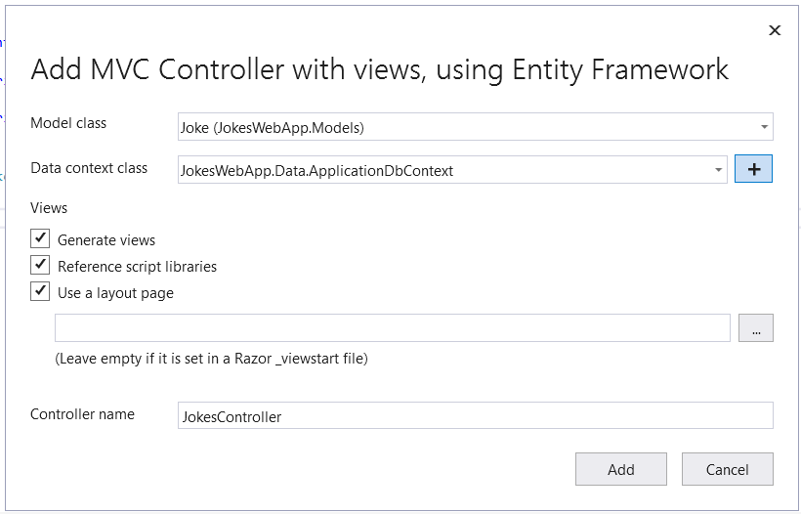
Controller
To Create new controller, right-click Controllers folder->Add->Controller->Select MVC Controller using Entity Framework.
Then follow the steps as shown below:
After creating JokesController file, Jokes folder generate under View folder.

